Slide 1
Modular Arithmetic
Several important cryptosystems make use of modular arithmetic. This is when the answer to a calculation is always in the range 0 – m where m is the modulus.
To calculate the value of n mod m, you take away as many multiples of m as possible until you are left with an answer between 0 and m.

Slide 2
If n is a negative number then you add as many multiples of m as necessary to get an answer in the range 0 – m.
Examples
17 mod 5 = 2 7 mod 11 = 7
20 mod 3 = 2 11 mod 11 = 0
-3 mod 11 = 8 -1 mod 11 = 10
25 mod 5 = 0 -11 mod 11 = 0

Slide 3
Two numbers a and b are said to be “congruent modulo n” if
(a mod n) = (b mod n) → a ≡ b(mod n)
The difference between a and b will be a multiple of n
So a-b = kn for some value of k
E.g: 4 ≡9 ≡ 14≡19 ≡ -1 ≡ -6 mod 5
73 ≡ 4(mod 23); 21 ≡ -9(mod 10)
If a ≡ 0 (mod n), then n|a.

Slide 4
Properties of Congruences
a ≡ b (mod n) if n|(a-b)
a ≡ b (mod n) implies b ≡ a (mod n)
a ≡ b (mod n) and b ≡ c (mod n) imply a ≡ c (mod n)
Proof of 1.
If n|(a-b), then (a-b) = kn for some k. Thus, we can write
a = b + kn. Therefore,
(a mod n) = (remainder when b + kn is divided by n) = (remainder when b is divided by n) = (b mod n).

Slide 5
Examples
23 ≡ 8 (mod 5) because 23 -8 =15 = 5x3
-11 ≡ 5 (mod 8) because -11-5 =-16 = 8x(-2)
81 ≡ 0 (mod 27) because 81-0=81 = 27x3

Slide 6
Properties of Modular Arithmetic
[(a mod n) + (b mod n)] mod n = (a + b) mod n
[(a mod n) - (b mod n)] mod n = (a - b) mod n
[(a mod n) x (b mod n)] mod n = (a x b) mod n
Proof of 1.
Let (a mod n) = Ra and (b mod n) = Rb. Then, we can write
a = Ra + jn for some integer j and b = Rb + kn for some integer k.
(a + b) mod n = (Ra + jn + Rb + kn) mod n
= [Ra + Rb + (k + j) n] mod n
= (Ra + Rb) mod n
= [(a mod n) + (b mod n)] mod n

Slide 7
Examples
11 mod 8 = 3; 15 mod 8 = 7
[(11 mod 8 ) + (15 mod 8)] mod 8 = 10 mod 8 = 2
(11 + 15) mod 8 = 26 mod 8 = 2
[(11 mod 8 ) - (15 mod 8)] mod 8 = -4 mod 8 = 4
(11 - 15) mod 8 = -4 mod 8 = 4
[(11 mod 8 ) x (15 mod 8)] mod 8= 21 mod 8 = 5
(11 x 15) mod 8 = 165 mod 8 = 5

Slide 8
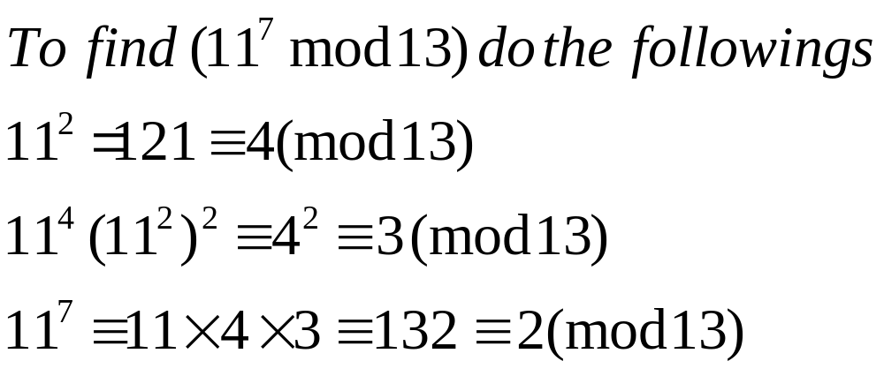
Exponentiation
Exponentiation is done by repeated multiplication, as in ordinary arithmetic.

Slide 9
Sage algorithm for modular exponentiation
that computes x^{n} mod m
def exp(x,n,m):
y=1; u=x % m
while (n >0):
if ((n % 2)=1):
y=(y*u) % m;
if (n > 0):
n=floor(n / 2);
u=(u*u) % m
Output y

Slide 10
A good thing about modular arithmetic is that the numbers you are working with will be kept relatively small. At each stage of an algorithm, the mod function should be applied.
Thus to multiply 39 * 15 mod 11 we first take mods to get
  39 mod 11 = 6 and 15 mod 11= 4
  The multiplication required is now
  6*4 mod 11 = 24 mod 11 = 2

Slide 11
Modular Division
What is 5 ÷ 3 mod 11?
We need to multiply 5 by the inverse of 3 mod 11
When you multiply a number by its inverse, the answer is 1.
Thus the inverse of 2 is ½ since 2* ½ = 1
The inverse of 3 mod 11 is 4 since 3*4=1 mod 11
Thus 5 ÷ 3 mod 11 = 5*4 mod 11 = 9 mod 11

Slide 12
Euclidean algorithm
gcd(a,b) = gcd(b, b mod a)
int Euclid(int a, int b) {
if (b == 0) return a;
else return Euclid(b, b % a)
}

Slide 13
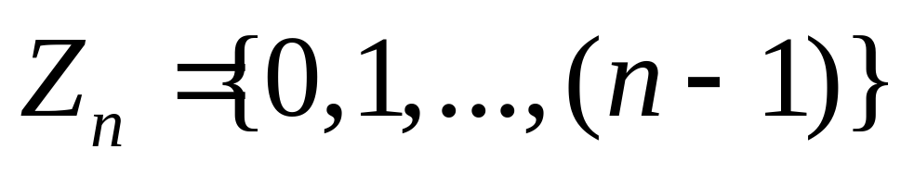
Properties of Modular Arithmetic
Define the set Z_{n} as the set of nonnegative integers less than n:
This set is referred to as the set of residues, or residue classes (mod n). That is, each integer in Zn represents a residue class.

Slide 14
Properties of Modular Arithmetic
We can label the residue classes (mod n) as:
[0],[1],[2],...,[n-1], where
[r] = {a: a is an integer, a ≡ r (mod n)}.
E.g.: The residue classes (mod 4) are
[0] = {..., -16,-12,-8,-4,0,4,8,12,16, ...}
[1] = {..., -15,-11,-7,-3,1,5,9,13,17, ...}
[2] = {..., -14,-10,-6,-2,2,6,10,14,18, ...}
[3] = {..., -13,-9,-5,-1,3,7,11,15,19, ...}

Slide 15
Properties of Modular Arithmetic
Property | Expression
Cummitative Laws | (w + x) mod n = (x + w) mod n (w x x) mod n = (x x w) mod n
Associative Laws | [(w + x) + y] mod n = [w + (x + y)] mod n [(w x x) x y] mod n = [w x (x x y)] mod n
Distributive Law | [w x (x + y)] mod n = [(w x x) + (w x y)] mod n
Identities | (0 + w) mod n = w mod n (1 x w) mod n = w mod n
Additive Inverse (-w) | For each w Z_{n}, there exists a z such that w + z ≡ 0 mod n

Slide 16
Modular Arithmetic
A Multiplication Table in Z_{n}: Summary
  The numbers that have inverses in Z_{n} are relatively prime to n
    That is: gcd(x, n) = 1
  The numbers that do NOT have inverses in Z_{n} have common prime factors with n
    That is: gcd(x, n) > 1

Slide 17
Modular Arithmetic
A Multiplication Table in Z_{n}: Summary
  The results have implications for division:
    Some divisions have no answers
      3 * x = 2 mod 6 has no solutions => 2/3 has no equivalent in Z₆
    Some division have multiple answers
      2 * 2 = 4 mod 6 => 4/2 = 2 mod 6
      2 * 5 = 4 mod 6 => 4/2 = 5 mod 6
    Only numbers that are relatively prime to n will be uniquely divisible by all elements of Z_{n}

Slide 18
Modular Arithmetic
A Multiplication Table in Z_{n}: Summary
  The results have implications for division:
    Zero divisors exist in some mods:
    3 * 2 = 0 mod 6 => 0/3 = 2 and 0/2 = 3 in mod 6
    3 * 6 = 0 mod 9 => 0/3 = 6 and 0/6 = 3 in mod 9

Slide 19
Modular Arithmetic
Finding Inverses in Z_{n}
  The numbers that have inverses in Z_{n} are relatively prime to n
  We can use the Euclidean Algorithm to see if a given “x” is relatively prime to “n”; then we know that an inverse does exist.
  How can we find the inverse without looking at all the remainders? A problem for large n.

Slide 20
Modular Arithmetic
Finding Inverses in Z_{n}
  The numbers that have inverses in Z_{n} are relatively prime to n
  We can use the Euclidean Algorithm to see if a given “x” is relatively prime to “n”; then we know that an inverse does exist.
  How can we find the inverse without looking at all the remainders? A problem for large n.

Slide 21
Modular Arithmetic
Finding Inverses in Z_{n}
  What is the inverse of 15 in mod 26?
  First use the Euclidean Algorithm to determine if 15 and 26 are relatively prime
    26 = 1 * 15 + 11
    15 = 1 * 11 + 4
    11 = 2 * 4 + 3
    4 = 1 * 3 + 1
    3 = 3 * 1 + 0
Then gcd (26, 15) = 1

Slide 22
Modular Arithmetic
Finding Inverses in Z_{n}
  What is the inverse of 15 in mod 26? Now we now they are relatively prime – so an inverse must exist.
  We can use the algorithm to work backward to create 1 (the gcd(26, 15)) as a linear combination of 26 and 15:
    1 = x * 26 + y * 15
  Why would we want to do this?

Slide 23
Modular Arithmetic
Finding Inverses in Z_{n}
  Convert 1 = x * 26 + y * 15 to mod 26 and we get:
  1 mod 26  (y * 15) mod 26
  Then if we find y we find the inverse of 15 in mod 26.
  So we start from 1 and work backward…

Slide 24
Modular Arithmetic
    26 = 1 * 15 + 11 => 11 = 26 – (1*15)
    15 = 1 * 11 + 4 => 4 = 15 – (1*11)
    11 = 2 * 4 + 3 => 3 = 11 – (2*4)
    4 = 1 * 3 + 1 => 1 = 4 – (1*3)
Step 1) 1 = 4 – (1 * 3) = 4 – 3
Step 2) 1 = 4 – (11 – (2 * 4)) = 3 * 4 - 11
Step 3) 1 = 3 * (15 – 11) – 11 = 3 * 15 – 4 * 11
Step 4) 1 = 3 * 15 – 4(26 – (1*15)
Step 5 ) 1 = 7 * 15 – 4 * 26 = 105 – 104 >>check

Slide 25
Modular Arithmetic
Finding Inverses in Z_{n}
  So, what is the inverse of 15 in mod 26?
  1 = 7 * 15 – 4 * 26 converts to
  1  7 * 15 mod 26
   7 is the inverse of 15 in mod 26
  Can you use the same result to show that 11 is its own inverse in mod 15?

Slide 26
Modular Arithmetic
Using the Extended Euclidean Algorithm
  Formalizing the backward steps we get this formula:
    y₀ = 0
    y₁ = 1
    y_{i} = (y_{i-2} – [y_{i-1} * q_{i-2}]); i > 1
  Related to the “Magic Box” method

Slide 27
Modular Arithmetic
Step 0 | 26 = 1 * 15 + 11 | y₀ = 0
Step 1 | 15 = 1 * 11 + 4 | y₁ = 1
Step 2 | 11 = 2 * 4 + 3 | y₂ = (y₀ – (y₁ * q₀)) = 0 – 1 * 1 mod 26 = 25
Step 3 | 4 = 1 * 3 + 1 | y₃ = (y₁ – (y₂ * q₁)) = 1 – 25 * 1 = -24 mod 26 = 2
Step 4 | 3 = 3 * 1 + 0 | y₄ = (y₂ – (y₃ * q₂)) = 25 – 2 * 2 mod 26 = 21
Step 5 | Note: q_{i} is in red above | y₅ = (y₃ – (y₄ * q₃)) = 2 – 21 * 1 = -19 mod 26 = 7

Slide 28
Modular Arithmetic
Using the Extended Euclidean Algorithm
  y₀ = 0
  y₁ = 1
  y_{i} = (y_{i-2} – [y_{i-1} * q_{i-2}]); i > 1
Try it for…
  13 mod 22
  17 mod 97

Slide 29
Modular Arithmetic
Using the Extended Euclidean Algorithm
  22 = 1 * 13 + 9 y[0]=0
  13 = 1 * 9 + 4 y[1]=1
  9 = 2 * 4 + 1 y[2]=0 - 1 * 1 mod 22 = 21
  4 = 4 * 1 + 0 y[3]=1 - 21 * 1 mod 22 = 2
  Last Step : y[4]=21 - 2 * 2 mod 22 = 17
  Check: 17 * 13 = 221 = 1 mod 22

Slide 30
Modular Arithmetic
Using the Extended Euclidean Algorithm
  97 = 5 * 17 + 12 x[0]=0
  17 = 1 * 12 + 5 x[1]=1
  12 = 2 * 5 + 2 x[2]=0 - 1 * 5 mod 97 = 92
  5 = 2 * 2 + 1 x[3]=1 - 92 * 1 mod 97 = 6
  2 = 2 * 1 + 0 x[4]=92 - 6 * 2 mod 97 = 80
  Last Step: x[5]=6 - 80 * 2 mod 97 = 40
  Check: 40 * 17 = 680 = 1 mod 97

Slide 31
Modular Arithmetic
Some good sources on the internet:
  http://www.antilles.k12.vi.us/math/cryptotut/extended_euclidean_algorithm.htm
  http://www.math.umbc.edu/~campbell/NumbThy/Class/BasicNumbThy.html
  http://www.promys.org/pft/pcmi/PCMI_01.pdf
Promys For Teachers Summer Program

